Slide 1
STAT 308 Applied Regression
Chapter 3

Slide 2
Data in R
Structure of R data:
Data Frame --- the data values for each subject in a matrix
List --- a vector or grouping of objects (variables)
Object – a vector of data values or the variable
Object Member --- data value

Slide 3
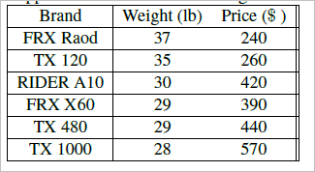
Adding Data
Vector using c() or concatenate
<variable name> = c(a, b, c, …, n)
Ex: Suppose we have the weight and price of mountain bikes
Code:
Brand = c(“FRX Road”, “TX 120”, “RIDER A10”, “FRX X60”, “TX 480”, TX 1000”)
Weight = c(37, 35, 30, 29, 29, 28)
Price = c(240, 260, 420, 390, 440, 570)
If you want to see the vector type the variable name.

Slide 4
Descriptive stats
Some internal functions to calculate stats:
mean(price)
sd(price)
summary(price)
Data Referencing - like a vector, you can reference a specific component or specific data value. For example we can find the price of the fifth bike
price[5]

Slide 5
Data Frame
Since all of the variables are in one data set, it makes sense to group them into one data frame or data set.
mbike = data.frame(brand, weight, price)
Referencing an object in a dataframe
<data frame>$<object>
Example
mbike$price
Referencing a data value from a dataframe
mbike[4,3]

Slide 6
Data Frame from a File
Text file
<data frame name> = read.table(<path of file>, header = TRUE (or FALSE), sep = “ “)
csv file
<data frame name> = read.csv(<path of file>, header = TRUE (or FALSE), sep = “ “)
Example
leadpoison = read.table(“C:/.../lead.txt”, header = TRUE)
Note the direction of the slashes.

Slide 7
Data Frame from a File Con’t
Another way to read from a file where you can point and click to the path.
leadpoison = read.table(file.choose(), header = TRUE)
To find out what is in the file use the head command:
head(leadpoison)

Slide 8
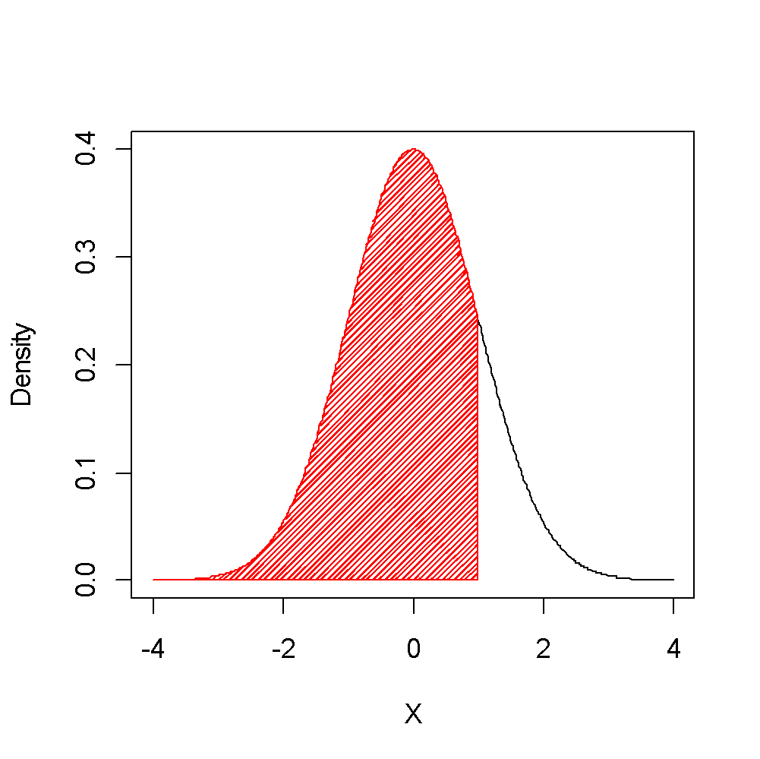
Probability Distributions and Sampling Distributions
To find P(z < 1) from a standard normal distribution
prob_z= pnorm(1,mean = 0, sd = 1)

Slide 9
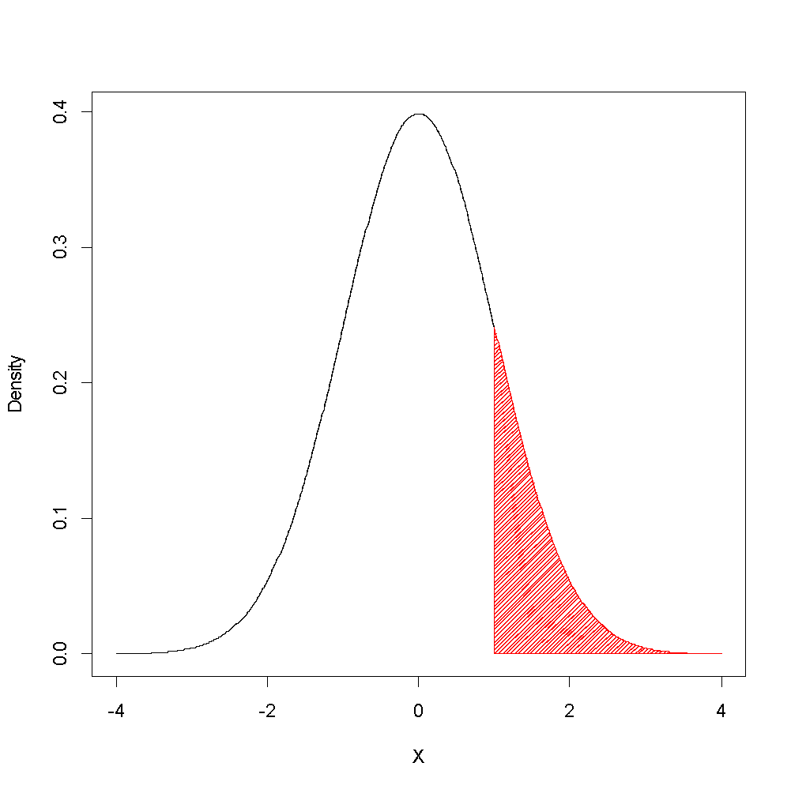
Probability Distributions and Sampling Distributions
To find P(z > 1) from a standard normal distribution
prob_z= 1- pnorm(1,mean = 0, sd = 1)

Slide 10
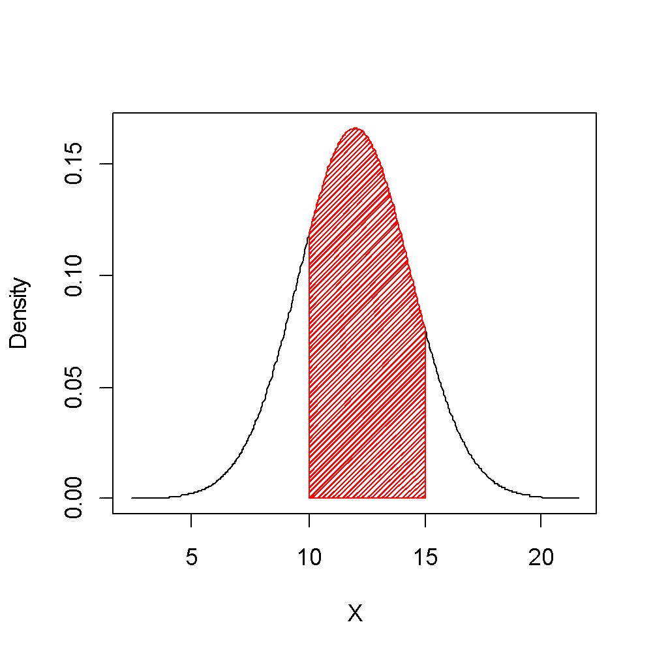
Probability Distributions and Sampling Distributions
Find P( 10 < x < 15) when μ = 12 and σ = 2.4
prob_x = pnorm(15,mean = 12, sd = 2.4) – pnorm(10, mean=12, sd = 2.4)

Slide 11
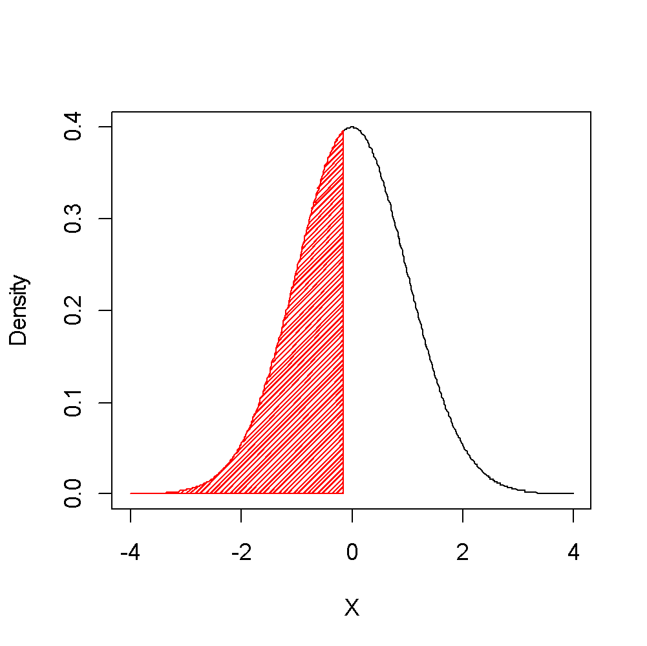
Probability Distributions and Sampling Distributions
To find P(z < ???) = 0.45 or the 45th percentile
0.45
z=qnorm(0.45,mean = 0, sd = 1)

Slide 12
Sampling Distribution
A sampling distribution is a distribution of all values of a statistic, like a mean, from all possible samples of size n from the population.
From the Central Limit Theorem, we know that sampling distributions are relatively normal if the original population distribution is normal or the sample size is large.
We usually compare sampling distributions to the t-distribution, the chi-squared distribution and the F-distribution.

Slide 13
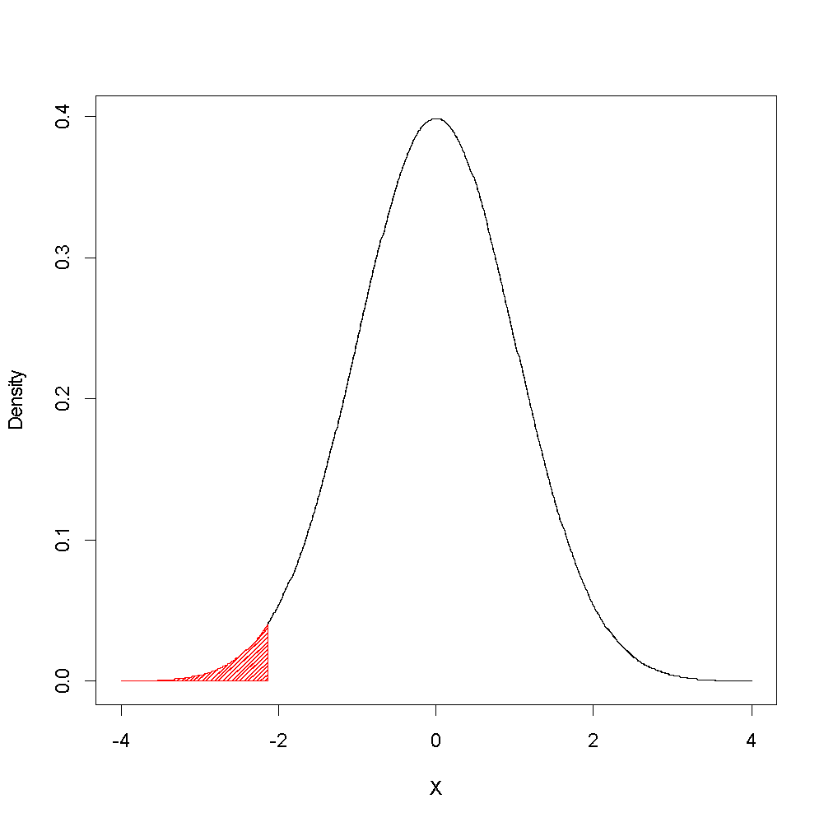
Probability Distributions and Sampling Distributions
To find P(t < -2.13) with df = 18
prob_t= pt(-2.13,df = 18)

Slide 14
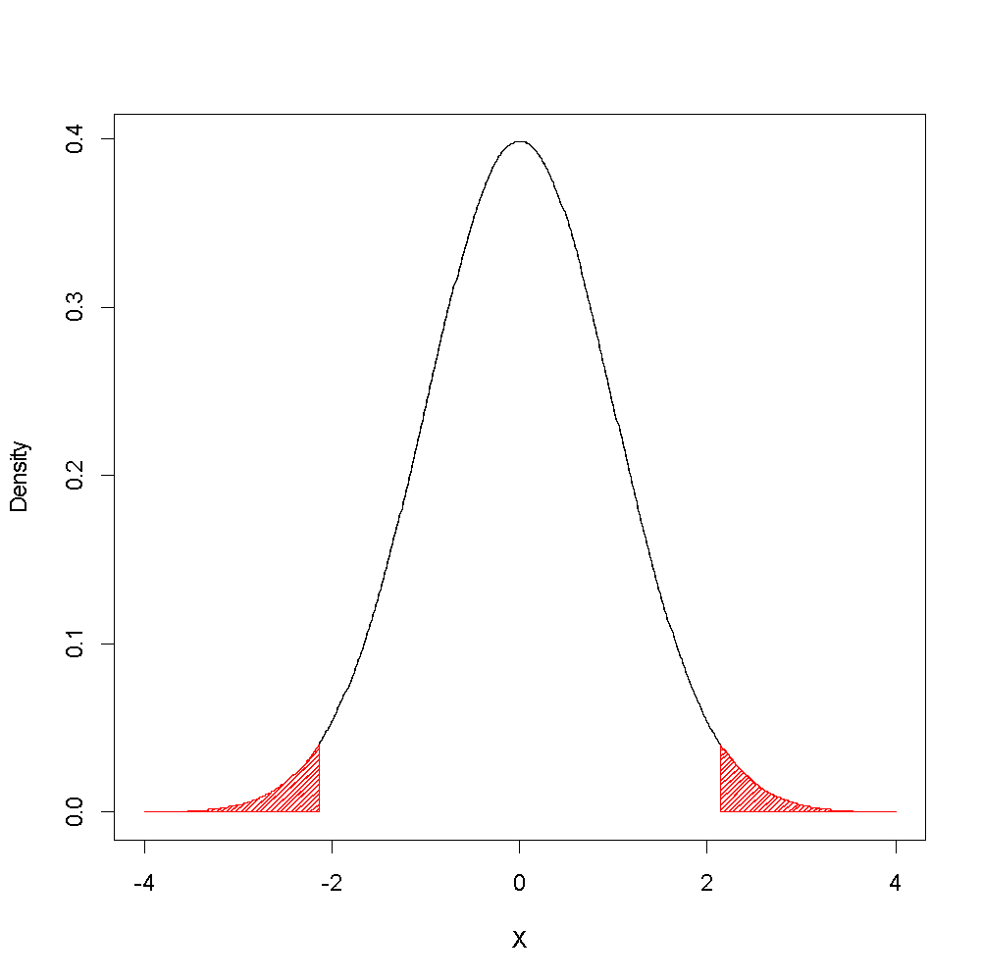
Probability Distributions and Sampling Distributions
To find P(|t| > 2.13) with df = 18
prob_t= pt(-2.13,df = 18) + (1 – pt(2.13,df = 18) )
Or
prob_t= 2*pt(-2.13,df = 18)
Or
prob_t = 2*(1 – pt(2.13,df = 18) )

Slide 15
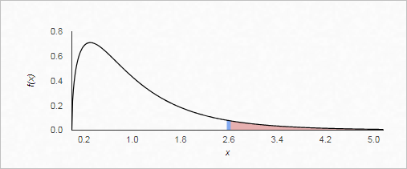
Probability Distributions and Sampling Distributions
To find P(F > 2.6) with df 1= 3 and df 2 = 22
prob_f= 1-pf(2.6, df1=3,df2=22)

Slide 16
Inferencing: Confidence Interval
Point Estimates – A point estimate is a single value to estimate a population parameter.
Confidence Interval - A confidence interval gives us a range of plausible values for population parameter.

Slide 17
Inferencing: Confidence Interval
IQV is an IQ score of verbal skills in our lead poisoning data.
Let’s create a 95% confidence interval for iqv and interpret it.
Sample mean = 84.6613
Sample sd = 13.5784
N = 124
se = 13.5784/sqrt(124) = 1.2194
t with df = 123 and α = 0.975 is 1.98
Lower Bound = 84.6613 - 1.98 × 1.2194 = 82.25
Upper Bound = 84.6613 + 1.98 × 1.2194 = 87.08
We are 95% confident the population mean iqv is a score between 82.25 and 87.08.

Slide 18
Inferencing: Confidence Interval
Find the 95% confidence interval for iqv using R
Find standard error of iqv for leadpoison data frame:
se = sd(leadpoison$iqv)/sqrt(length(leadpoison$iqv))
Find t-value
tvalue = qt(0.975, df=length(leadpoison$iqv) - 1)
Lower Bound/Upper Bound
lowbound = mean(leadpoison$iqv) – tvalue*se
upbound = mean(leadpoison$iqv) + tvalue*se
Interpret the CI!

Slide 19
Inferencing: Hypothesis Testing
Hypothesis Test – A method for building evidence about a population parameter (like μ) from a sample statistic (like x(bar) )
Two hypothesis:
Null hypothesis (H₀) - The null hypothesis is the hypothesis under investigation. It is a statement that there is no difference, no change, everything is status quo.
Alternative hypothesis (H₁ or H_{a}) – there is a difference. This is the research hypothesis. We are going to build evidence for this.

Slide 20
Inferencing: Hypothesis Testing
Procedure:
Check Assumptions that the variable of interest meets the criteria for the underlying distribution.
State the null and alternative hypothesis.
Determine an appropriate significance level, α.
Compute the test statistic and p-value from the data.
Compare the p-value to the significance level.
Make a conclusion:
If p-value > α, fail to reject the null hypothesis. There is insufficient evidence to demonstrate a difference.
If p-value < α, reject the null hypothesis. There is sufficient evidence to demonstrate a difference may exist.

Slide 21
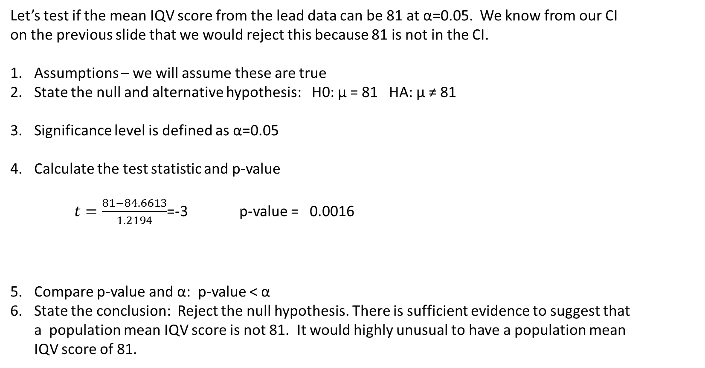
T-Test

Slide 22
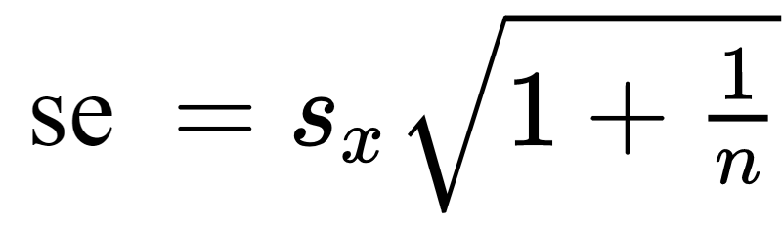
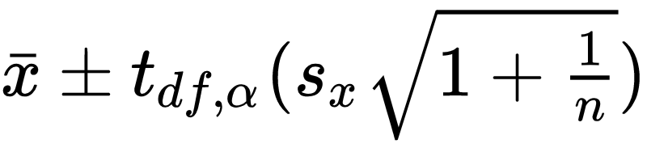
Prediction Intervals
Suppose we want to predict the IQV of a person not in our sample. This is different than predicting the mean. As you might imagine, there is more variability in the prediction of an individual than in the prediction of the population mean. Therefore, we would expect the prediction interval for an individual to be longer than the confidence interval for a mean.
Standard Error of a Prediction:
Prediction Interval:

Slide 23
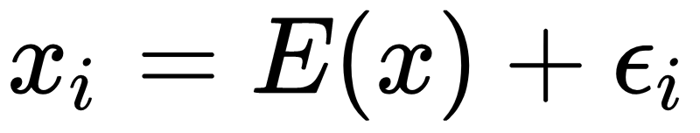

Prediction Interval
Quick Theory on standard error of prediction:
Let x_{i} be the predicted value and E(x) be the fixed expected value or mean. Then,
The CI of the prediction is
where is the means of the sampling distribution .

Slide 24
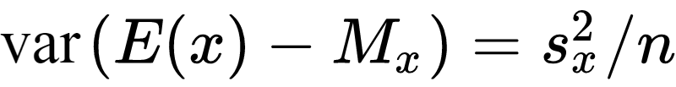
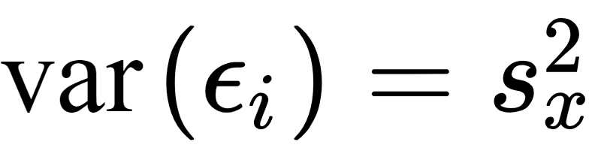
Prediction Interval
Consider the variances of the following:
Therefore:

Slide 25
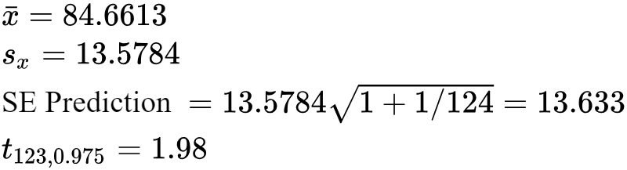
Prediction Interval
Example:
Calculate the 95% prediction interval for a IQV
Lower Bound = 84.6613 - 1.98 × 13.633 = 57.6680
Upper Bound = 84.6613 + 1.98 × 13.633 = 111.6546
We are 95% confident a randomly selected person similar to our population will have an IQV between 57.668 and 11.6546.

